Slide 1
LEAD SCORING CASE STUDY
Submitted by:
Rohit Mishra
Aditya Pratap Rai
DS C43

Slide 2
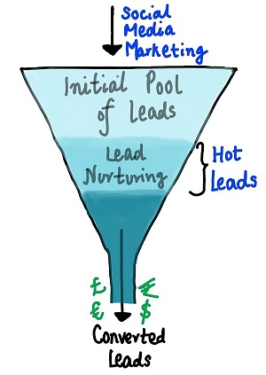
PROBLEM STATEMENT
An education company named X Education sells online courses to industry professionals. On any given day, many professionals who are interested in the courses land on their website and browse for courses.
The company markets its courses on several websites and search engines like Google. Once these people land on the website, they might browse the courses or fill up a form for the course or watch some videos. When these people fill up a form providing their email address or phone number, they are classified to be a lead. Moreover, the company also gets leads through past referrals. Once these leads are acquired, employees from the sales team start making calls, writing emails, etc. Through this process, some of the leads get converted while most do not. The typical lead conversion rate at X education is around 30%.
Now, although X Education gets a lot of leads, its lead conversion rate is very poor. For example, if, say, they acquire 100 leads in a day, only about 30 of them are converted. To make this process more efficient, the company wishes to identify the most potential leads, also known as ‘Hot Leads’. If they successfully identify this set of leads, the lead conversion rate should go up as the sales team will now be focusing more on communicating with the potential leads rather than making calls to everyone. A typical lead conversion process can be represented using the following funnel:

Slide 3
As you can see, there are a lot of leads generated in the initial stage (top) but only a few of them come out as paying customers from the bottom. In the middle stage, you need to nurture the potential leads well (i.e. educating the leads about the product, constantly communicating etc. ) in order to get a higher lead conversion.
X Education has appointed you to help them select the most promising leads, i.e. the leads that are most likely to convert into paying customers. The company requires you to build a model wherein you need to assign a lead score to each of the leads such that the customers with higher lead score have a higher conversion chance and the customers with lower lead score have a lower conversion chance. The CEO, in particular, has given a ballpark of the target lead conversion rate to be around 80%.

Slide 4
GOALS AND OBJECTIVES
There are quite a few goals for this case study.
Build a logistic regression model to assign a lead score between 0 and 100 to each of the leads which can be used by the company to target potential leads. A higher score would mean that the lead is hot, i.e. is most likely to convert whereas a lower score would mean that the lead is cold and will mostly not get converted.
There are some more problems presented by the company which your model should be able to adjust to if the company's requirement changes in the future so you will need to handle these as well. These problems are provided in a separate doc file. Please fill it based on the logistic regression model you got in the first step. Also, make sure you include this in your final PPT where you'll make recommendations.

Slide 5
RESULTS EXPECTED
A well-commented Jupyter note with at least the logistic regression model, the conversion predictions and evaluation metrics.
The word document filled with solutions to all the problems.
The overall approach of the analysis in a presentation
Mention the problem statement and the analysis approach briefly
Explain the results in business terms
Include visualisations and summarise the most important results in the presentation
A brief summary report in 500 words explaining how you proceeded with the assignment and the learnings that you gathered.

Slide 6
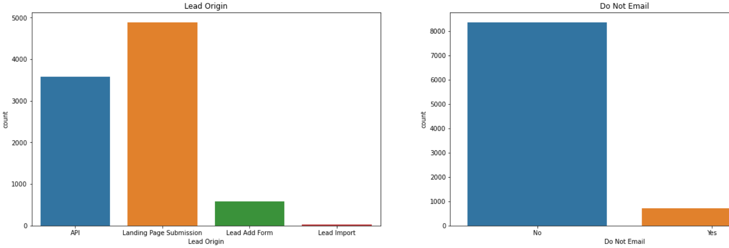
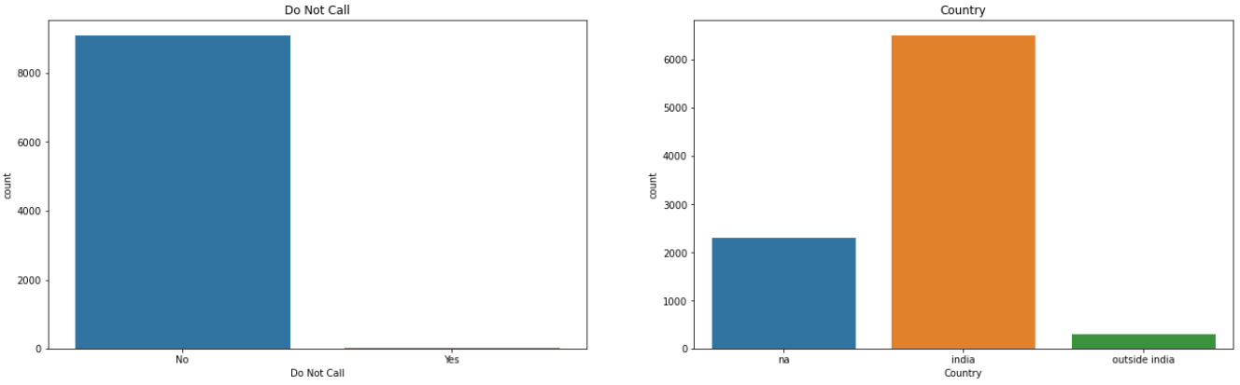
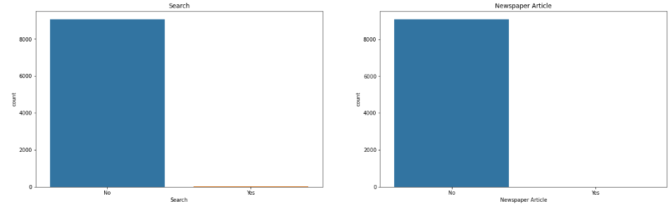
Exploratory Data Analysis (EDA)
Landing page & Api has highest count for lead profile and Lead ADD form & lead import has very less count.
Most of people, more than 8000 are responded Yes for Do not email and only few users below 1000, responded as yes for Do Not Email
More than 8000 people responded as No for Do not call and only few people responded as yes for 'Do No call', 'Search', 'Newspaper Article', 'X Education' AND 'Newspaper'

Slide 7
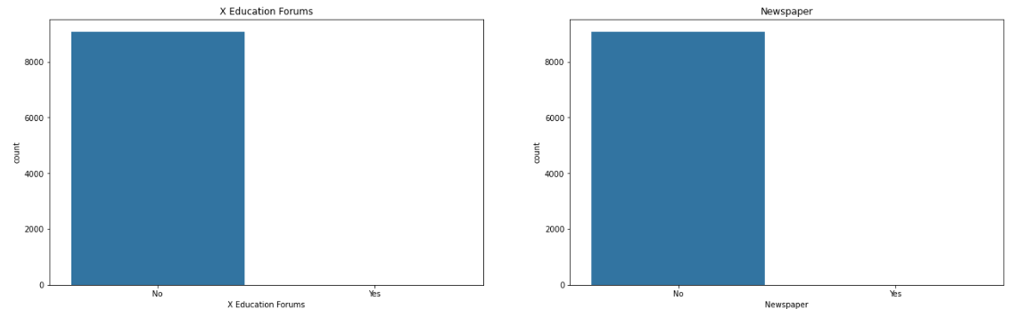
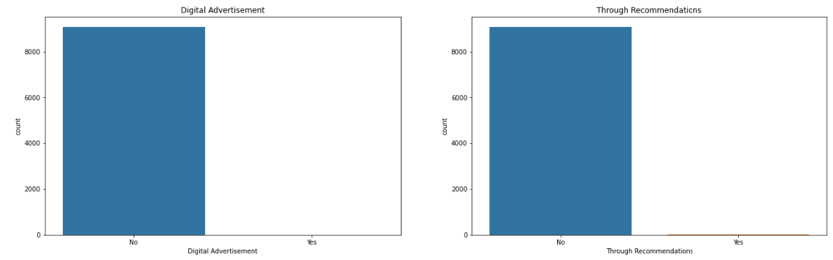
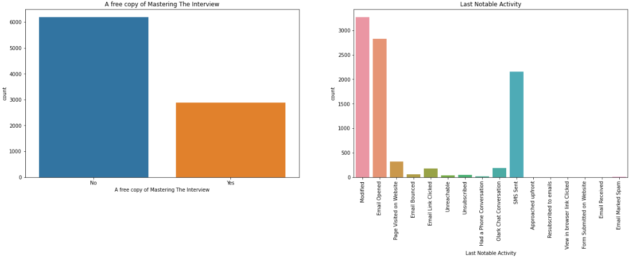
Most of people responded from India, few of them responded from outside of india and around 2200 users not responded for country
More than 6000 users responded as no and almost 3000 users responded as yes for 'A free Copy Of Mastring In Interview'
In Last activity Modified, email opened, sent msg have higher number of count

Slide 8
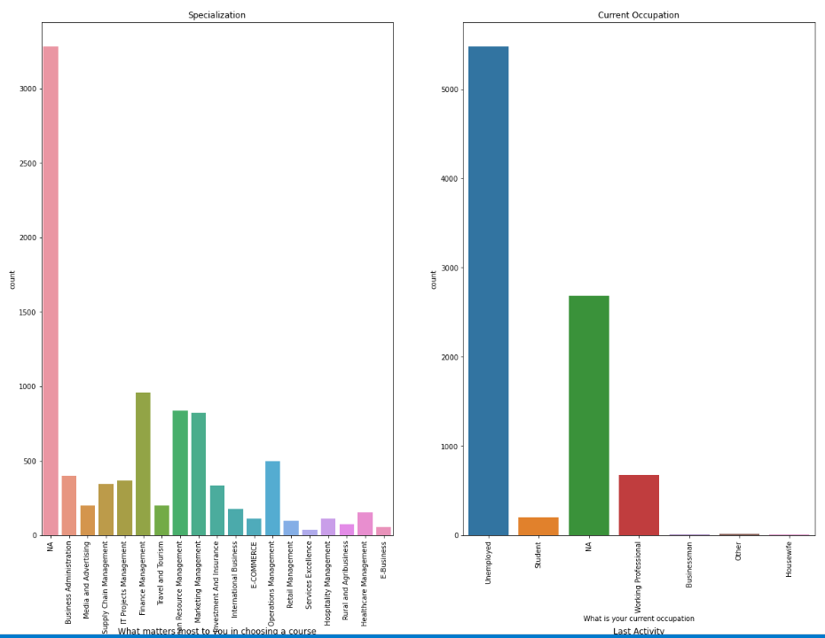
More than 3000 users not resonded for specialization details, Top 3 specialization selected by users is 1.Finance Management, 2. human Resources Management, 3. Marketing Management

Slide 9
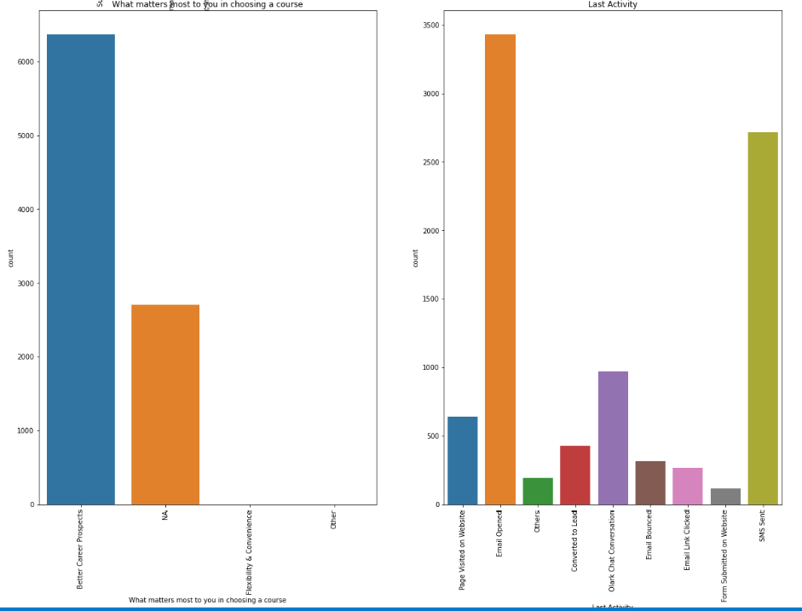
Mostly users are unemplyed. More than 6000 users are joined the course for Batter career perspective

Slide 10
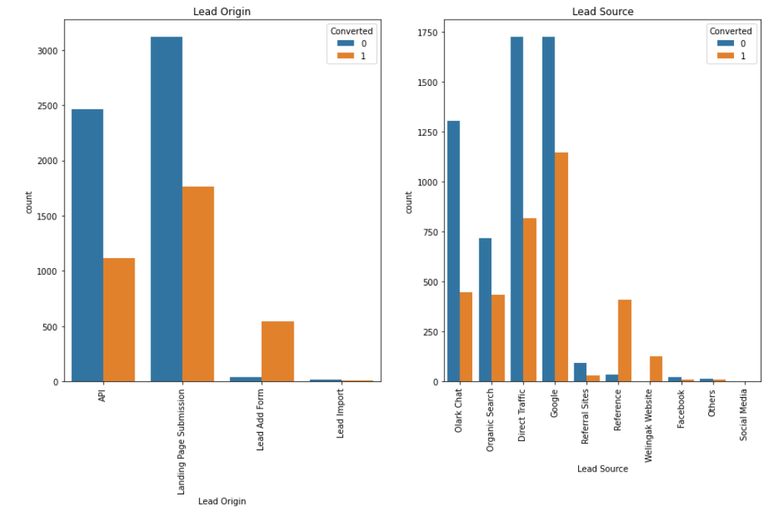
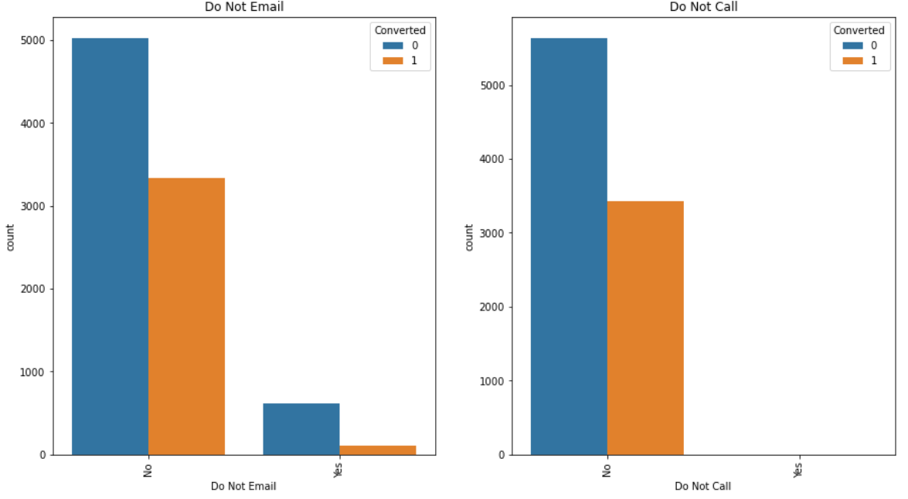
Bivariate Analysis

Slide 11
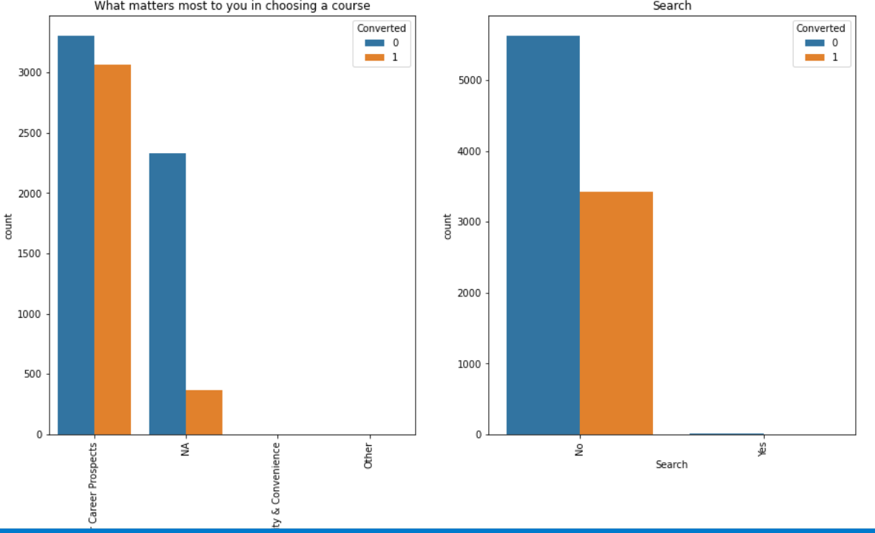
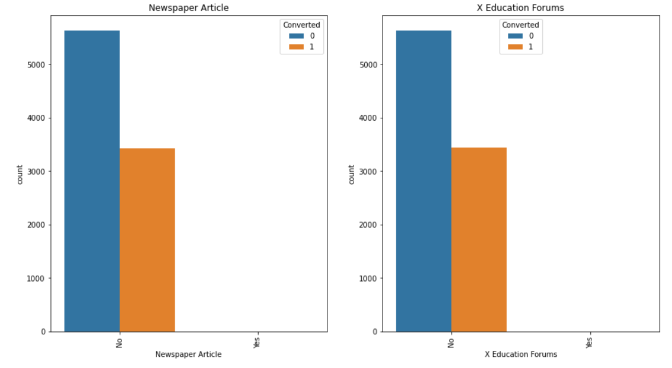
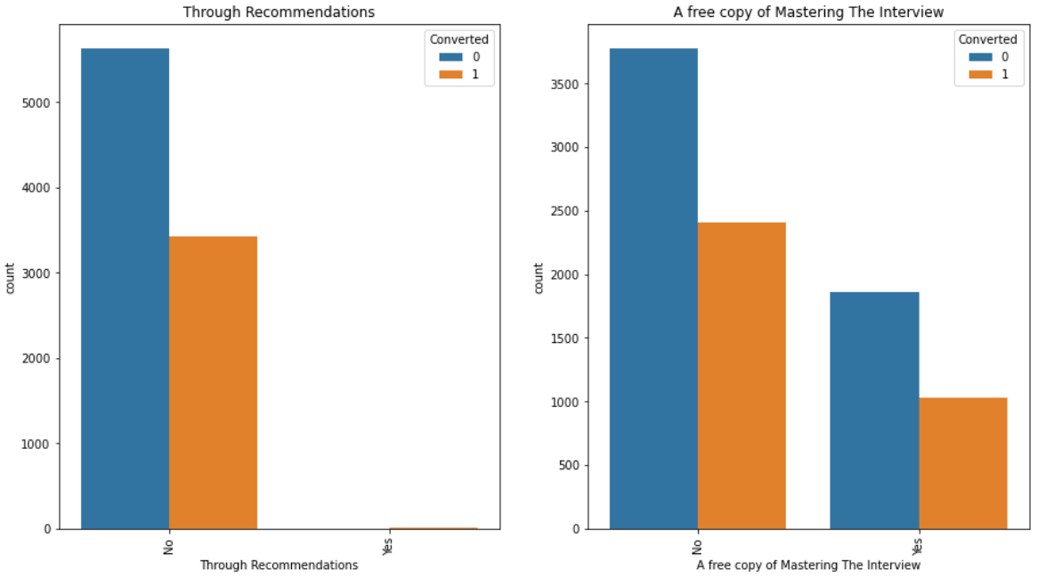
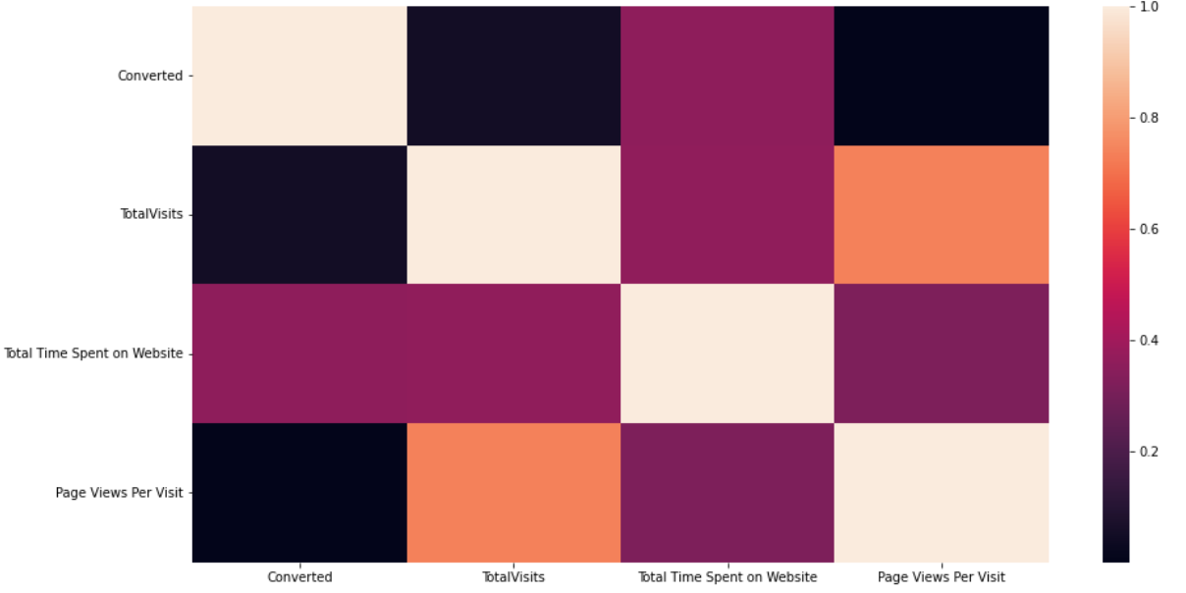

Slide 12
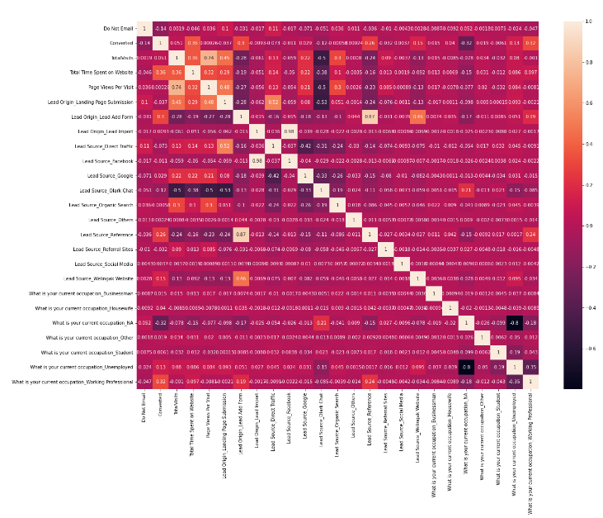

Slide 13
DATA CONVERSION
Numerical Variables are Normalised
Dummy Variables are created for object type variables
Total Rows for Analysis: 8792
Total Columns for Analysis: 43

Slide 14
Splitting the Data into Training and Testing Sets
The first basic step for regression is performing a train-test split, we have chosen 70:30 ratio.
Use RFE for Feature Selection
Running RFE with 15 variables as output
Building Model by removing the variable whose p-value is greater than 0.05 and VIF value is greater than 5
Predictions on test data set
Overall accuracy 81%

Slide 15
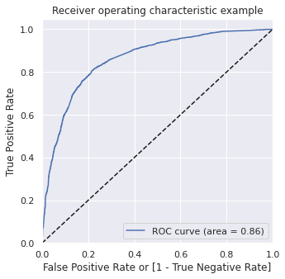
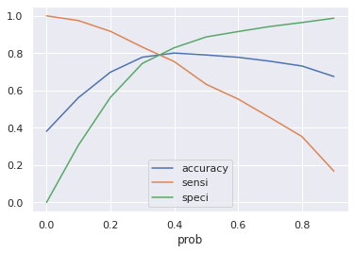
ROC CURVE
The ROC Curve should be a value close to 1. We are getting a good value of 0.86 indicating a good predictive model.
From the curve above, 0.3 is the optimum point to take it as a cutoff probability.

Slide 16
CONCLUSION
Below are the points via which we can a get a understanding between a hot lead and a cold lead
The total time spend on the Website.
Total number of visits.
When the lead source was from the below sites:
a. Google
b. Direct traffic
c. Organic search
d. Welingak website
When the lead origin is Lead add format
When their current occupation is as a working professional.

